Slide 1
Machine Learning – Support Vector Machines

Slide 2



Support Vector Machine
Support Vector Machine (SVM) algorithms are used in Classification.
Classification can be viewed as the task of separating classes in feature space.
x₂
2
1
0
1 2 3 4 5
6
x₁

Slide 3
Support Vector Machines
Here we select 3 Support Vectors to start with.
They are S₁, S₂ and S₃.
x₂
2
1
𝑆 =
1
2
S₁
1
2
−1
4
0
𝑆₂ =
0
1 2 3 4 5
6
x₁
-1
S₃
𝑆₃ =
-2
S₂
Click here to see the video

Slide 4
Support Vector Machines
Here we will use vectors augmented with a 1 as a bias input, and for clarity we will differentiate these with an over-tilde. That is:
2
1
𝑆₁ =
2
−1
𝑆₂ =
4
0
𝑆₃ =

Slide 5
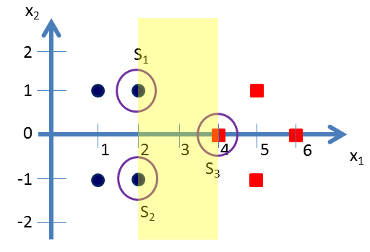









Support Vector Machines
Now we need to find 3 parameters 𝛼₁, 𝛼₂, and 𝛼₃ based on the following 3 linear equations:
𝛼₁𝑆₁. 𝑆₁ + 𝛼₂𝑆₂. 𝑆₁ + 𝛼₃𝑆₃. 𝑆₁ = −1 (−𝑣𝑒 𝑐𝑙𝑎𝑠𝑠)
𝛼₁𝑆₁. 𝑆₂ + 𝛼₂𝑆₂. 𝑆₂ + 𝛼₃𝑆₃. 𝑆₂ = −1 (−𝑣𝑒 𝑐𝑙𝑎𝑠𝑠)
𝛼₁𝑆₁. 𝑆₃ + 𝛼₂𝑆₂. 𝑆₃ + 𝛼₃𝑆₃. 𝑆₃ = +1 (+𝑣𝑒 𝑐𝑙𝑎𝑠𝑠)

Slide 6
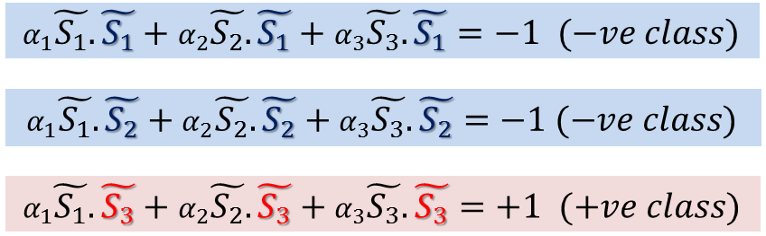
Support Vector Machines
2
1
1
2
1
1
2
1
1
2
−1
1
2
−1
1
2
1
1
4 2
0 1
1 1
𝛼₁
.
+ 𝛼₂
.
+ 𝛼₃
.
= −1
2
2
. −1 + 𝛼₃
1
4 2
0 −1
1 1
𝛼₁
.
+ 𝛼₂
−1
1
.
= −1
4 4
0 0
1 1 1 1
2 4
1 0
1 1
2
−1
4
0
𝛼₁
. + 𝛼₂
.
+ 𝛼₃ .
= +1

Slide 7
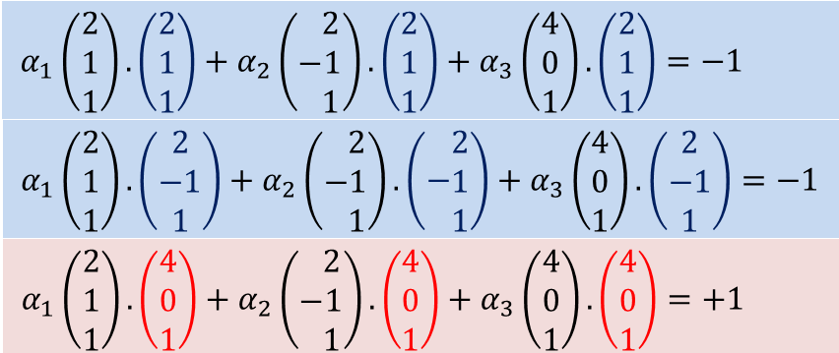




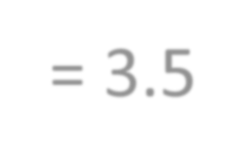





Support Vector
Machines
After simplification we get:
6𝛼₁ + 4𝛼₂ + 9𝛼₃ = −1
4𝛼₁ + 6𝛼₂ + 9𝛼₃ = −1
9𝛼₁ + 9𝛼₂ + 17𝛼₃ = +1
Simplifying the above 3 simultaneous equations we get: 𝛼₁=𝛼₂= -3.25 and 𝛼₃= 3.5.

Slide 8
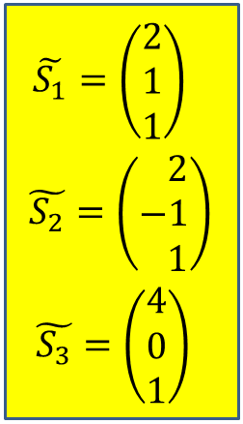
Support Vector Machines
The hyper plane that discriminates the positive class from the negative class is give
by:
Substituting the values we get:
2
1
1
2
−1
1
4
0
1
𝑤 = 𝛼₁
+ 𝛼₂
+ 𝛼₃
 |  | 2 |  |  | 2 |  |  | 4 |  | 1
𝑤 = | −3.25 . | 1 | + | −3.25 . | −1 | + | 3.5 . | 0 | = | 0
 |  | 1 |  |  | 1 |  |  | 1 |  | −3

Slide 9
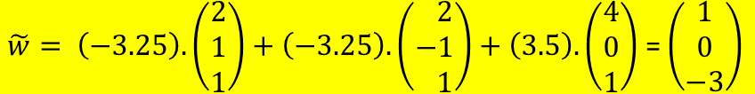
Support Vector Machines
Our vectors are augmented with a bias.
Hence we can equate the entry in 𝑤 as the hyper plane with an offset b.
Therefore the separating hyper plane equation
1
𝑦 = 𝑤𝑥 + 𝑏 with 𝑤 = and offset 𝑏 = −3.
0

Slide 10



Support Vector Machines
1
0
𝑦 = 𝑤𝑥 + 𝑏 with 𝑤 =
and offset 𝑏 = −3.
x₂
2
S₁
1
0
1 2 3 4
5
6
x₁
-1
S
3
-2
S₂
This is the expected decision surface of the LSVM.

Slide 11

Support Vector Machines – Classification Examples
Let′s take the 5 support vector version
𝑤 = [ 0 1 -1]. This is a horizontal line passing through x2=1.
Let’s classify the point (x1,x2)=(4,2).
𝑤. 𝑥 =
Hence this point belongs to the red class
Let’s classify the point (x1,x2)=(2,-2).
𝑤. 𝑥 =
Hence this point belongs to the blue class
We can do the same for any new point.
x₂
0 . 4
2
= 2 > 1
1 2
1
0
1 2 3 4 5
6
x₁
0 . 2
1 −2
-1
= −2 < 1
-2
Click here to see the video

Slide 12
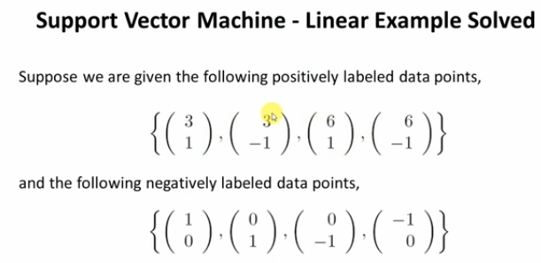

Slide 13
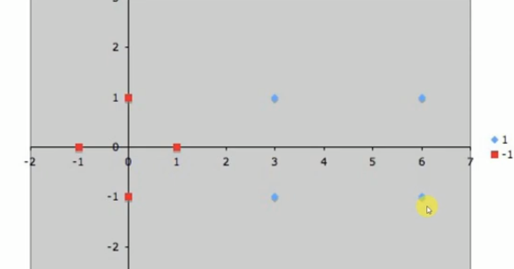

Slide 14
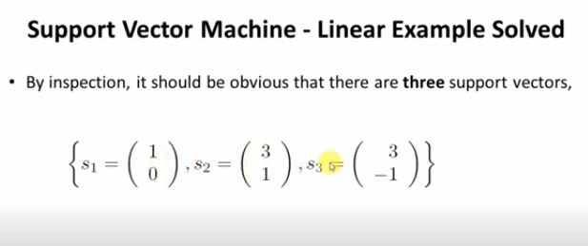
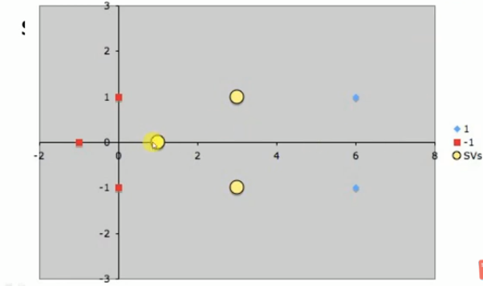

Slide 15
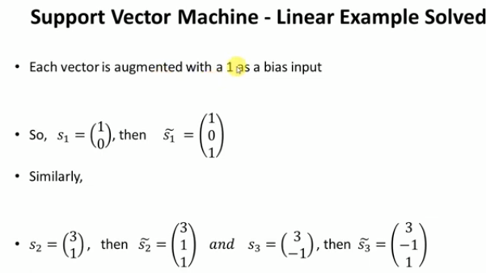

Slide 16
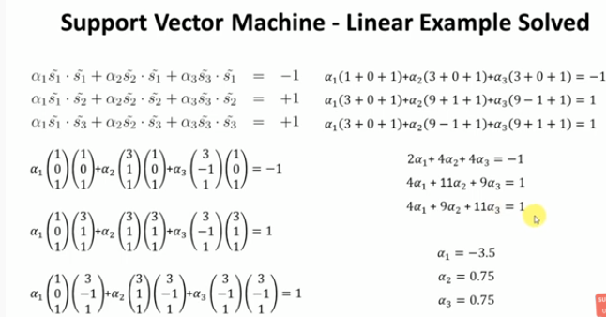

Slide 17
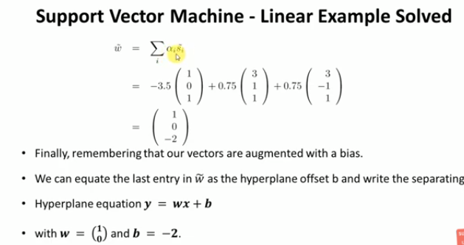

Slide 18
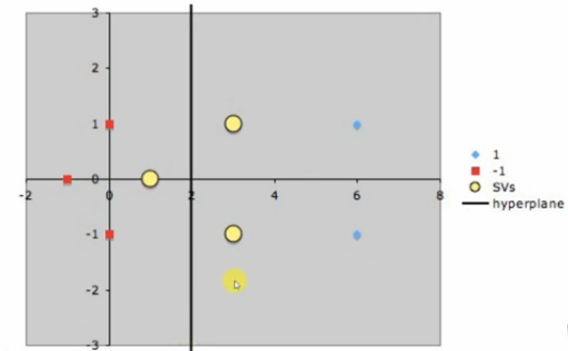

Slide 19
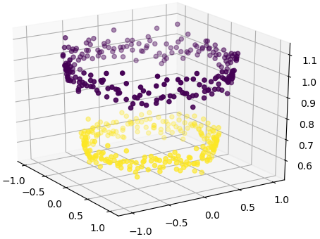
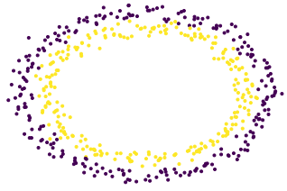
Support Vector Machines
Here we will look at an example like the one given below and find out how to carry out the classification.
Obviously there is no clear separating hyperplane between the

Slide 20
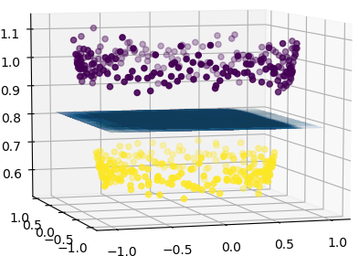
Support Vector Machines
Here we will look at an example like the one given below and find out how to carry out the classification.
Obviously there is no clear separating hyperplane between the

Slide 21



Support Vector Machines
Here we will look at an example like the one given below and find out how to carry out the classification.
Obviously there is no clear separating hyperplane between the
red class and the blue class.
x₂
2
1
-3
-2
-1
-1
0 1
2 3
x₁
-2

Slide 22

Support Vector Machines - Non-linear
x₂
2
1
-3
-2
-1
-1
0 1
2 3
x₁
-2
1 −1 −1 1
1 1 −1 −1
2 0 −2
0 2 0
Blue class vectors are:
,
,
,
0
−2
Red class vectors are:
,
,
,

Slide 23
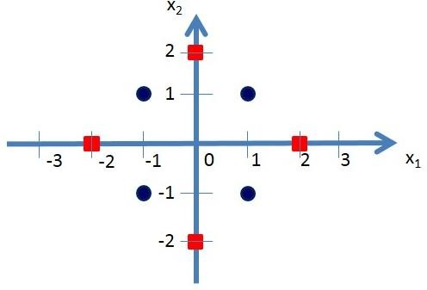
Support Vector Machines - Non-linear
Here we need to find a non-linear mapping function Φ which can transform these data in to a new feature space where a seperating hyperplane can be found.
Let us consider the following mapping function.
2
2
6 − 𝑥₁ + 𝑥₁ − 𝑥₂
𝑥₁
𝑥
if 𝑥² + 𝑥² ≥ 2
1 2
Φ
=
6 − 𝑥₂ + 𝑥 − 𝑥
1
𝑥₁
𝑥₂
2
2
otherwise
Click here to see the video

Slide 24
Support Vector Machines - Non-linear
Now let us transform the blue and red calss vectors using the non-linear mapping function Φ .
6 − 𝑥₁ + 𝑥₁ − 𝑥₂
2
𝑥₁
𝑥
if 𝑥² + 𝑥² ≥ 2
1 2
6 − 𝑥 + 𝑥 − 𝑥
2
Φ
=
2
1
𝑥₁
𝑥₂
2
2
otherwise
1 −1 −1 1
1 1 −1 −1
Blue class vectors are:
,
,
,
no change since
𝑥² + 𝑥² < 2 for all the vectors
1 2

Slide 25
Support Vector Machines - Non-linear
2
2
6 − 𝑥₁ +
𝑥₁ − 𝑥₂
𝑥₁
𝑥
if 𝑥² + 𝑥² ≥ 2
1 2
Φ
=
6 − 𝑥 + 𝑥 − 𝑥
2
1
𝑥₁
𝑥₂
2
2
otherwise
2 0
0 2
−2
0
0
−2
Let us take Red class vectors :
,
,
,
𝑥₁
𝑥₂
𝑥₁
𝑥₂
𝑥₁
𝑥₂
𝑥₁
𝑥₂
2
0
0
2
−2
0
0
−2
6 − 2 +
6 − 0 +
6 − 0 +
6 − 2 +
2 − 0 ²
2 − 0 ²
0 − 2 ²
0 − 2 ²
8
10
10
8
Φ
= Φ
=
=
Φ
= Φ
=
=
6 + 2 +
6 − 0 +
6 − 0 +
6 + 2 +
−2 − 0 ²
−2 − 0 ²
12
10
10
12
Φ
= Φ
=
=
0 + 2 ²
0 + 2 ²
Φ
= Φ
=
=

Slide 26

𝑥₁
Φ
𝑥₂
6 − 𝑥₁ +
Vectors After
Transforming
2
2
𝑥₁ − 𝑥₂
if 𝑥² + 𝑥² ≥ 2
1 2
=
6 − 𝑥₂ + 𝑥 − 𝑥
1 2
𝑥₁
𝑥₂
otherwise
𝑥₁
𝑥₂
𝑥₁
𝑥₂
𝑥₁
𝑥₂
𝑥₁
𝑥₂
2
0
0
2
−2
0
0
−2
8
10
10
8
12
10
10
12
Φ
= Φ
=
13
12
Φ
= Φ
=
11
10
Φ
= Φ
=
9
8
Φ
= Φ
=
7
6
5
4
3
2
1
-3
-2 -1
0
1
2 3 4 5
6
7 8 9 10
11 12
-1
-2

Slide 27
Selection of Support Vectors
Now our task is to find suitable support vectors to classify these two classes.
Here we will select the
following 3 support vectors:
8
13
S₁
12
11
10
9
8
𝑆 = ,
7
S
1
10
10
8
6
2
𝑆₂ =
,
5
4
S₃
1
1
3
and 𝑆₃=
2
1
-3
-2 -1
0
1
2 3 4 5 6 7 8
9 10
11 12
-1
-2
Click here to see the video

Slide 28
Augmented Support Vectors
Here we will use vectors augmented with a 1 as a bias input, and for clarity we will differentiate these with an over-tilde. That is:
8
10
𝑆₁ =
10
8
𝑆₂ =
1
1
𝑆₃ =

Slide 29
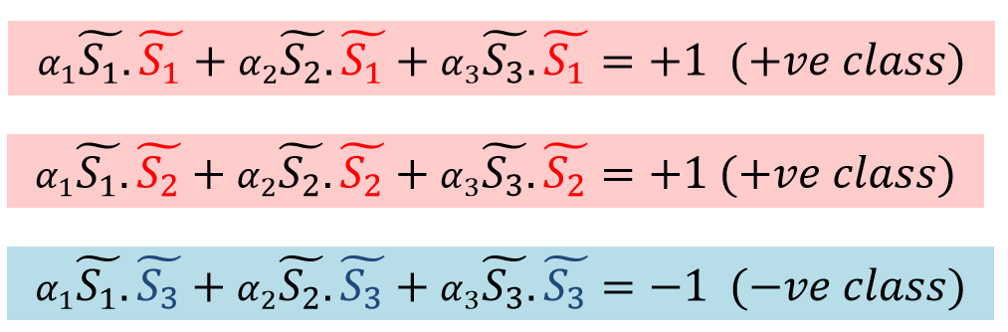
Finding Parameters
Now we need to find 3 parameters 𝛼₁, 𝛼₂, and 𝛼₃ based on the following 3 linear equations:

Slide 30
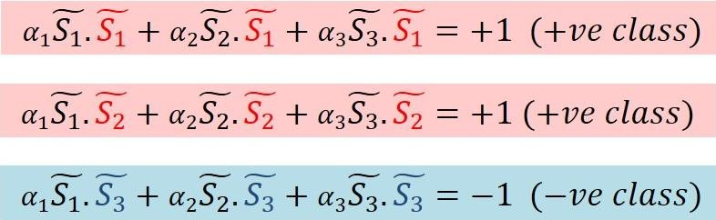
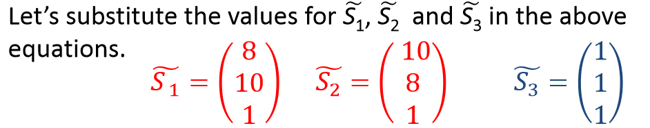
Substituting
Support Vectors

Slide 31
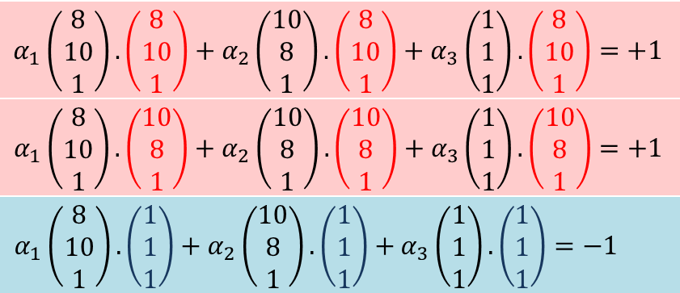

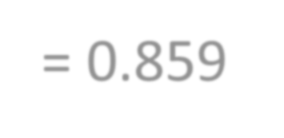


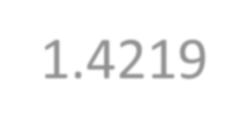




Simultaneous
Equations
After multiplication we get:
165 𝛼₁ + 161 𝛼₂ + 19 𝛼₃ = +1
161 𝛼₁ + 165 𝛼₂ + 19 𝛼₃ = +1
19 𝛼₁ + 19 𝛼₂ + 3 𝛼₃ = −1
Simplifying the above 3 simultaneous equations we get: 𝛼₁=𝛼₂= 0.0859 and 𝛼₃= -1.4219.

Slide 32
Discriminating Hyper Plane

Slide 33
Equation for Discriminating Hyper Plane
Our vectors are augmented with a bias.
Hence we can equate the entry in 𝑤 as the hyper plane with an offset b.
Therefore the separating hyper plane equation
0.1243/0.1243
0.1243/0.1243
1
1
𝑦 = 𝑤𝑥 + 𝑏 with 𝑤 =
=
and an offset 𝑏 = −
1.2501
= −10.057.
0.1243

Slide 34



Hyper Plane Seperating the Two Classes
𝑦 = 𝑤𝑥 + 𝑏 with
1
13
S₁
12
11
𝑤 = and offset
10
1
9
8
𝑏 = −10.057.
7
S
6
2
5
4
S₃
3
2
1
-3
-2 -1
0
1
2 3 4 5 6
7 8
9 10
11 12
This is the expected decision surface of the Non LSVM.
-1
-2

Slide 35


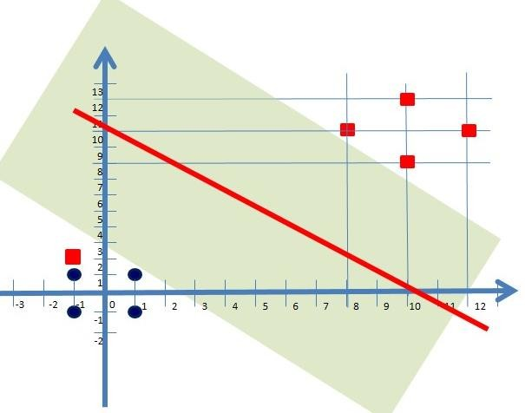
𝑥₁
Φ
𝑥₂
6 − 𝑥₁ +
Non-Linear Support Vector Machines – Classification Examples
2
2
𝑥₁ − 𝑥₂
if 𝑥² + 𝑥² ≥ 2
1 2
=
6 − 𝑥₂ + 𝑥 − 𝑥
1 2
𝑥₁
𝑥₂
otherwise
Let′s consider a classification example here.
Let’s classify the point (x₁,x₂)=(-1,2).
Φ
x₂
2
𝑥₁
𝑥₂
−1
2
1
= Φ
=
6 + 1 + −1 − 2
6 − 2 + −1 − 2
2
2
=
16
13
-1
-1
-3
-2
0 1
2 3
x₁
𝑤. Φ(𝑥) =
Hence this point belongs to the red class.
1 16
1 13
.
= 29 > 10
-2

Slide 36
Important Note

Slide 37
References
https://scholastic.teachable.com/courses/pattern-classification/lectures/1462510
https://scholastictutors.webs.com/

Slide 38
Thanks

